Slide 1
ID3 Presentation team 3

Slide 2
ID3 Introduction
ID3 Presents a major shift in what we’re doing on the project
From plans to reality
Spikes => Project infrastructure
Testing Implementation
Logging
Issue Tracking
Pair Programming
Code Reviews

Slide 3
New Features
Multiple users.
Create, save, or load projects.
Create different elements on the model.
Link elements together.
System authentication.
Editing the diagram.
Persistence.

Slide 4
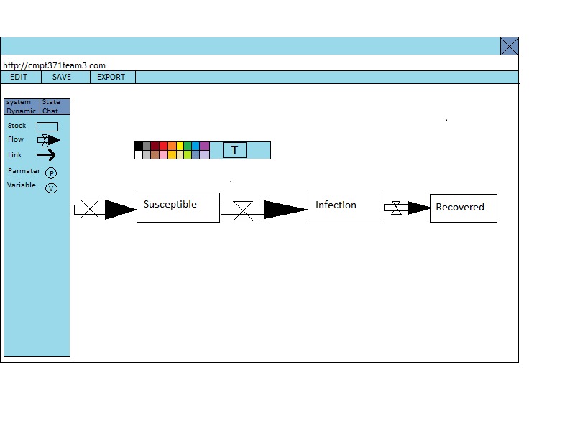
Expected result

Slide 5
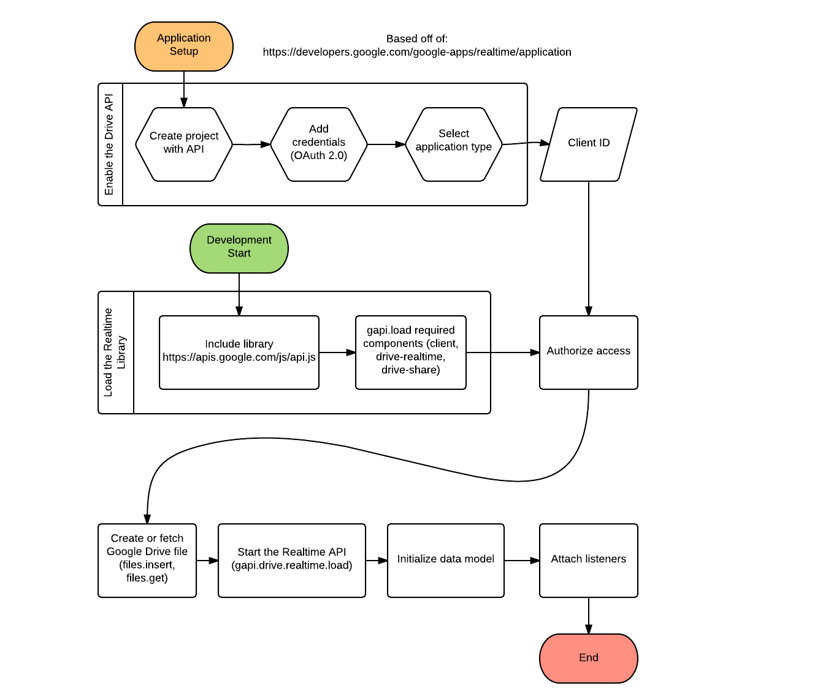
Low level flow diagram for Google products

Slide 6
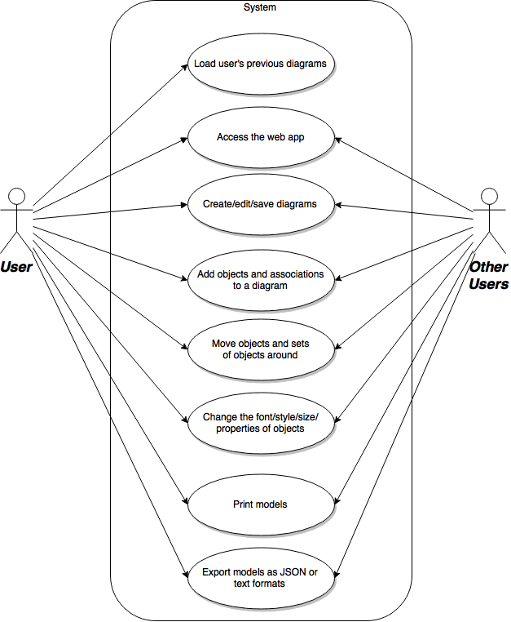
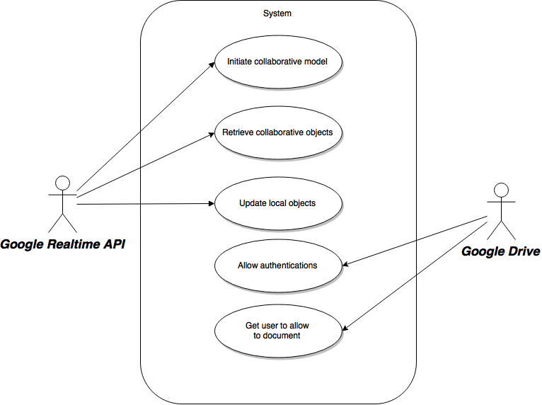
updated use-case diagram

Slide 7
Implementation For ID3
Fine grained collaboration
Allows realtime updating
Multiple interactions simultaneously
Launching from Google Drive
Handle redirect url
joint.js integrated
Plug into powerful graphing library
Speed up building new nodes
Rest of project easier

Slide 8
Implementation For ID3
Transitioning into a fully working system
We’ve focused primarily on back-end behaviour this deliverable.
The underlying system has been made as bug-free and generic as possible
Easy extension and modification of the system
The user can do a “basic” version of most functionality.
Hooks for more specific behaviour have been implemented
Not yet integrated into the GUI.

Slide 9
Testing team
New in ID3:
Added automated Selenium tests
Runs on Travis CI
Currently tests authentication and verifies if objects do get added to the canvas
Runs tets on Firefox and Chrome
Populated test case document
Added a testing matrix
Populated testing matrix with the current test cases

Slide 10
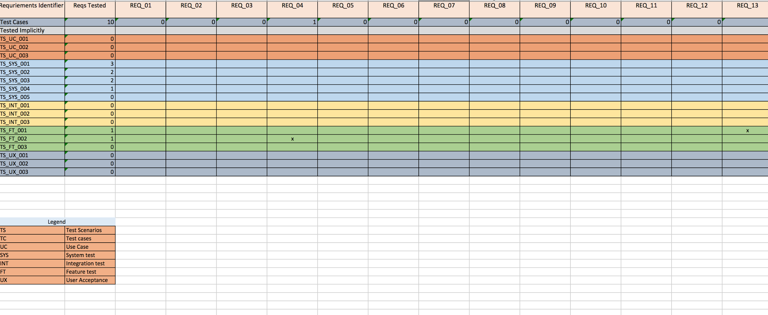
Test Matrix
Notes:
This is a snippet of the test matrix as the text matrix is fairly huge.

Slide 11
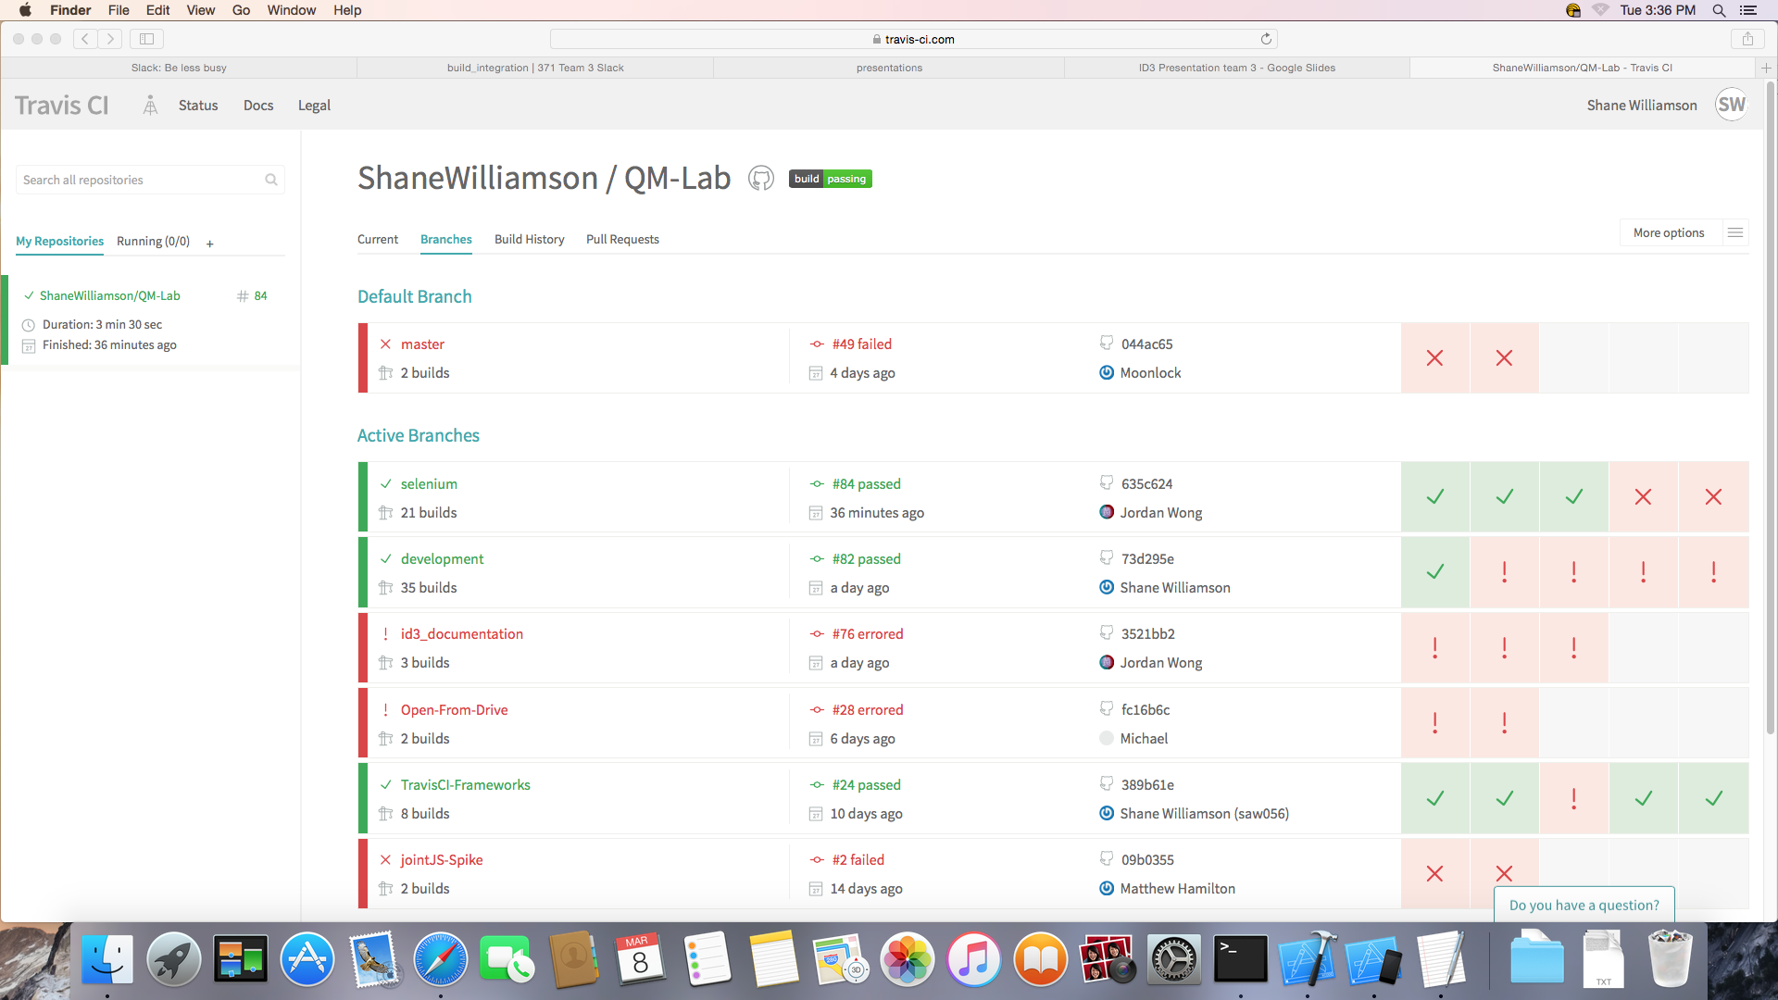
Build and Continuous Integration
Travis-CI is fully operational.
Performs tests based on commands in .travis.yml file.
Feeds notifications on build status to both email and slack.

Slide 12
Where do we go from here?
The next deliverable, ID4, will present another shift.
From infrastruscture to feature completion.
Ranking features by their risk, time and the Stakeholder’s preference.
Might higher focus on many kinds of testing.
Unit tests, coverage, mocking and more automation tests
UI polish

